Slide 1
Creating Questionnaires
Dedicated Time Presentation
August 12th, 2020
Version: 1.0
Presentation Authors: John Brown
Human Factors Engineering (HFE)
Office of Health Informatics (10A7A)
Veterans Health Administration

Slide 2
Questionnaires
What is a questionnaire?
A conversation
Subjective
A snapshot of respondent's viewpoint.
Advantages and Disadvantages
Advantages
Low cost, access to large diverse samples, ease of completion, rapid response rate, ease of analysis, method familiarity, timely, uniform question presentation, anonymous.
Disadvantages
Low response rate, reliability concerns, validity concerns, question limitations, prejudice against questionnaires, impersonal, sample limitations, question presentation and form completion process, item interdependence, missed questions, respondent behavior.

Slide 3
Begin from research question
What is your research question?
What are the topics?
Is a survey the best method to collect the data that you need?
What variables are in your ideal dataset?

Slide 4
What questions and answers mean
Think about the differences between what questions and answers mean to you vs. respondents.
Every question must have a purpose – what do you want to learn from this item? How certain are you that it will be used in your analysis?
Every question should produce the best possible data for your purpose – “someone else in my field thought this was a good question 30 years ago” may or may not be a good enough rationale.
Every question will one-day be a variable – make your future self happy by designing variables that behave nicely.

Slide 5
Wording Matters in Questions and Answer Options
The need for a good question or stem.
Novice questionnaire designers often focus on determining the appropriate scale [still important] and don’t devote adequate time developing a well-constructed stem or question. The reality is that of your stem or question is not prepared properly, it won’t make any difference what scale you select—you are going to wind up studying noise and bias. ~Moroney and Cameron (2019)
What’s a stem? [question for the group]

Slide 6
Wording of Questions Shapes the Answers
As researchers, we tend to view our questionnaires as measurement devices that elicit information from respondents. What we frequently overlook is that our questionnaires are also a source of information that respondents draw in order to determine their task and arrive at a useful and informative answer. ~Norbert Schwartz (1999)
In other words respondents use the information and its wording as a basis for how they answer.
This is one of the key reasons that different public opinion polls can have such different results on the same topic.
“How fast were the cars going when they SMASHED into each other” vs. “About what speed were the cars going when they collided.”
A study (Loftus and Palmer 1974) of similarly worded questions indicated the verb used impacted [pun not intended] the range of responses.

Slide 7
Wording Matters in Questions and Answer Options
Use straightforward language familiar to your respondents.
Keep it short, simple, familiar, active voice, professional, typo free with correct grammar, terse and precise [but nice].
Ask the right question.
Give them a question they can answer that is relevant.
Don’t use filter questions.
Select right attributes, characteristics or variables.
Would you recommend… vs. how satisfied… vs. how satisfied with [ATTRIBUTE/CHARACTERISTIC/VARIABLE]…
Provide appropriate context for question and instructions.
When you were last…
Since your last …
In the following section we will consider…
Use an appropriate frame of reference.
Don’t ask what social class, rather ask about income, wealth…
Don’t ask “double barreled” questions.
How hungry and tired are you?

Slide 8
Wording Matters in Questions and Answer Options
Use the right answer options and scales for the question and the type of information you are looking to collect.
“A researcher also can falsely economize by using scales that are too brief in the hope of reducing the burden on respondents. Choosing a questionnaire that is too brief to be reliable is a bad idea no matter how much respondents appreciate its brevity. . . Respondents’ completing “convenient” questionnaires that cannot yield meaningful information is a poorer use of their time and effort than their completing a somewhat longer version that produces valid data. ~Devellis (2003, p.12-13)

Slide 9
Response Options/Scales Shape the Answers
Scale selection impacts how respondents answer, as illustrated in an Internet survey by Smyth, Dillman, and Christian (2007)
How many hours per day do you typically study? Would you say…
Three different groups were offered the same question with different scales”
Low range, started at a half hour or less and topped out at more than 2 ½ hours.
High range, started at 2 ½ hours or less and topped at more that 4 ½ hours.
Fill in hours in blank.
The results flipped between low and high range options when seen from a up to 2 ½ hours and more than 2 ½ hours.
The low range group answered 70.2% studied up to 2 ½ hours and the high range group answered 71.1% studied more than 2 ½ hours.
Same question just different answers scales.

Slide 10
Adverb Intensifiers
Adverbs
Thomas Edison once said, ''If we did all the things we are capable of, we would literally astound ourselves.'' In this quote, the word 'literally' is an adverb that's used as an intensifier. An adverb is a word that's used to describe or change the meaning of an adjective, verb, or another adverb.
An intensifier is an adverb that is used to describe the intensity of the word that is being modified. Sometimes intensifiers are used to amplify the meaning of a verb, adverb, or adjective; other times they're used to downplay a word. Let's look at the proper use of intensifiers in writing.

Slide 11
Types of Adverb Intensifiers
Intensifiers are descriptive words that help explain feelings or ideas associated with an action. There are four types of intensifiers:
Emphasizers
Amplifiers
Downtoners
Premodifiers
Emphasizers are adverbs that highlight the intensity of a verb, adverb, or adjective. Examples include: Definitely, Apparently, Really, Basically, Literally, Certainly.
Amplifiers are adverbs that increase the intensity of the words they're modifying. For example: Entirely, Totally, Indisputably, Absolutely, Remarkably.
Downtoners are adverbs that downplay the intensity of a verb, adverb, or adjective. Examples include: Kind of, Somewhat, Sort of, Slightly, A little, Merely, Nearly,
Premodifiers are adverbs that alter the intensity of the modified word. For example: Very, Relatively, Rather

Slide 12
Adverb Intensifiers in Questionnaires
Care should be given in the consideration to the intensifiers to use.
Should enable the respondent a way to answer that fits their insight and feelings.
If used incorrectly can drive respondents to a particular answer.
“This is clearly the answer they WANT me to pick…”
Examples of the type of scales used for different question intentions and the intensifiers that go with each, can be found in:
Appendix D: Sample of Likert-Type Scales of Questionnaire Design (Moroney and Cameron 2019)

Slide 13
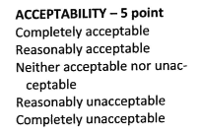
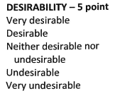
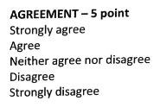
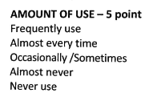
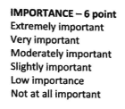

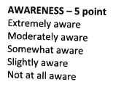
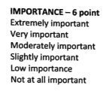
Examples

Slide 14
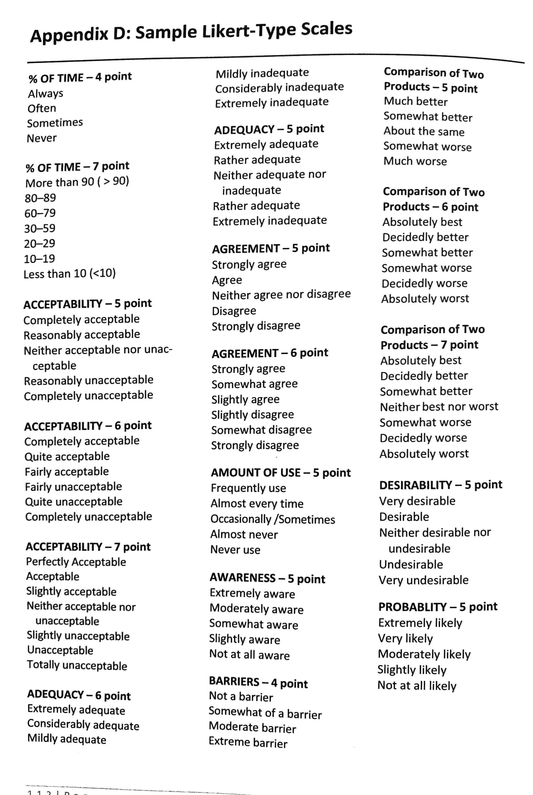
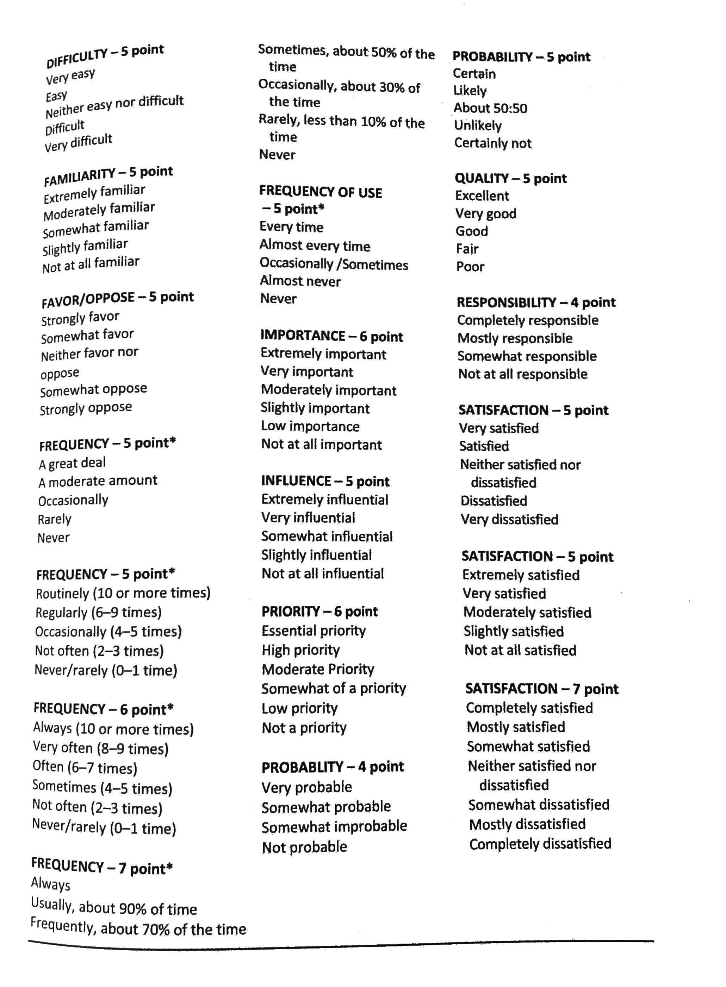
Examples Continued

